Slide 1
TCP congestion control
TLC Networks Group
firstname.lastname@polito.it
http://www.tlc-networks.polito.it/
Notes:
Marco:
- corretto titolo (!!!) TPC -> TCP :)
- aggiunto slides 20-23 per far vedere come RWND può limitare prestazioni se RTT*banda alto
- aggiunto slide 68 su CUBIC per mostrare funzione cubica.

Slide 2
TCP protocol
TCP (Transmission Control Protocol )
Already reviewed
  Fundamentals
  Port mechanism
    Socket
  Header format

Slide 3
References
Richard Stevens: TCP Illustrated
RFC 793 (1981)
  Transmission Control Protocol
  Updated by RFC 3168 (ECN) RFC 6093, RFC 6528
RFC 7323 (updates RFC 1323 in1992)
  TCP Extensions for High Performance
RFC 5681 (obsoletes RFC 2581):
  TCP Congestion Control
RFC 6582 (obsoletes RFC 3782 and RFC 2582):
  The NewReno Modification to TCP's Fast Recovery Algorithm
RFC 2883 (obsoletes RFC 2018 defined in 1996):
  An Extension to the Selective ACKnowledgement (SACK ) Option for TCP
RFC 6298 (obsoletes RFC 2988):
  Computing TCP's Retransmission Timer

Slide 4
TCP connection opening
(three-way handshake)
  Three-way handshake
  Client executes an active open, server executes a passive open
  ISN (initial sequence number) is randomly generated
  A SYN uses one sequence number
source (client) destination (server)
SYN / ISN_{c}
<MSS_{c}>
SYN / ISN_{s}
<MSS_{s}>
ACK / ISN_{c}+1
ACK / ISN_{s}+1
time

Slide 5
TCP connection closing
(half-close)
source (client) destination (server)
close request
from application
FIN / Seq. Numb._{c}
EOF to higher layers
ACK (Seq.Numb._{C}+1)
FIN / Seq. Numb._{s}
close request
from application
EOF to
Higher layers
Timed_wait
ACK (Seq. Numb._{s}+1)

Slide 6
Connection management: client
closed
send SYN
Wait for 30 s
Re-send ACK
If a new FIN
arrives
Re-send if
Timeout expires
(3s+backoff)
Time_wait
SYN_sent
10 minutes if
server idle
receive SYN & ACK
Send ACK
receive FIN
send ACK
FIN_wait_2
established
receive ACK
send data;
client side ends connection
sending FIN
FIN_wait_1
Re-send if timeout expires.

Slide 7
Notes
The Timed_wait state avoids that old segments belonging to closed connections may interfere with new connections
Timed_wait should be “aligned” to TTL, today a timer set to 30s is used
During the Timed_wait state, socket (ports) cannot be used
BSD implementation passes from FIN_wait_2 to closed in 10 minutes, of the server does not send any data in the meantime

Slide 8
Connection management: server
closed
Server application
creates socket
receive ACK
Re-send if timeout expires.
last_ACK
listen
receive SYN
send SYN & ACK
send FIN
Re-send if
timeout expires
(3s+backoff)
close_wait
SYN_rcvd
Receive FIN, send ACK
(client connection closed)
established
Receive ACK

Slide 9
TCP State Transition Diagram
Example of TCP connections opened by the client and closed by the server
client
CLOSED
PassiveOpen
Close/
server
ActiveOpen/SYN
LISTEN
SYN/SYN+ACK
Send/SYN
server
SYN/SYN+ACK
client
Close/
SYN_RCVD
SYN_SENT
ACK /
server
SYN+ACK /ACK
ESTABLISHED
client
Close/FIN
FIN/ACK
Close/FIN
server
client
FIN_WAIT_1
CLOSE_WAIT
ACK /
FIN/ACK
Close/FIN
server
CLOSING
client
ACK /
FIN_WAIT_2
LAST_ACK
FIN+ACK /ACK
ACK /
FIN/ACK
server
timeout after 2 segment lifetimes
TIME_WAIT

Slide 10
Self-clocking behavior
P_{r}
P_{b}
TX
RX
A_{b}
A_{s}
A_{r}
Segments are spaced within a RTT according to the bottleneck link rate

Slide 11
TCP transmitter
Fragments data application in segments
Computes and transmits checksum over header and data
Window with Go BACK N retransmission (but!)
Activates timer when sending segments:
  Unacknowledged segments induce retransmissions after a timeout expiration
Like any window protocol, transmission speed ruled by window size
  Flow and congestion control

Slide 12
TCP receiver
Discards segments with CRC errors
Stores out of sequence segments
  Selective repeat like behaviour
Re-orders out of sequence segments
  Delivers an ordered and correct data stream to application process
Cumulative ACKs
Declares in the window field of the TCP header the amount of available buffer space to control transmitter sending rate (flow control)

Slide 13
TCP receiver
In sequence and correct segment
  Store the segment (eventually passing it to higher layer protocols) and send a cumulative ACK
Duplicate segment
  Discard the segment and send a cumulative ACK with the number of the last segment received in sequence
Segment with checksum error
  Discard the segment; no ACK sent
Out of sequence segment
  Store the segment (non mandatory, but de facto standard) and send a cumulative ACK with the number of the last segment received in sequence (duplicate ACK )

Slide 14
Transmitter window
Maximum admissible window size
Segment sequence
number
Available window
1 2 3 4 5 6 7 8 9 10
Segments not yet
transmitted
Segments transmitted,
ACK not received
Segments that
cannot be transmitted
Segments transmitted,
ACK received
Notes:
15

Slide 15
Transmitter window dynamics
When an ACK referring to a new segment is received, the transmitter window:
  Move to the right by the segment size
  It is possible to transmit a new segment
When a new segment is transmitted, the available window is reduced by a segment
If the available window goes to zero, segment transmission is stopped
Notes:
17

Slide 16
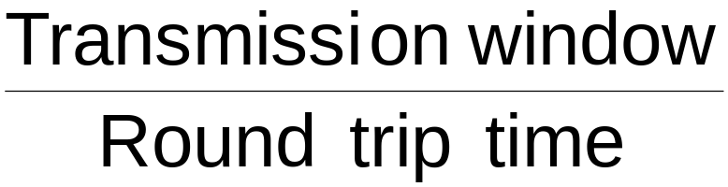
Flow and congestion control
For any window protocol, the transmission bit rate in absence of errors is:
“Short” connections (small RTT) obtain higher bit rate
To regulate transmission bit rate (objective of both flow and congestion control), control
  Round trip time (delay ACK transmission)
    But generates retransmissions due to timer at the sender
  Transmission window size
Notes:
12

Slide 17
Flow and congestion control
TCP: transmitter bit rate regulated by both:
  Flow control
  Congestion control
Flow control: avoid to saturate a slow receiver
  The receiver controls the speed of the sender
  Congestion control: avoid to saturate the network (more precisely, the link which becomes the bottleneck link)
  The network controls the speed of the sender
  Data are stored in node buffer
    Under congestion
      Buffer occupancy increases
      Round trip increases, and bit rate decreases
      This is not enough to control congestion: packet get dropped because of finite queue size
Notes:
12

Slide 18
Flow and congestion control
TCP transmitter window size is regulated:
  Flow control: receiver declares the available window size (rwnd) (available receiver buffer)
  Congestion control: the transmitter computes a congestion window (cwnd) value as a function of segment losses detected by missing ACKs
    Timeout expiration
    Duplicate ACKs
The actual transmitter window size is the minimum between the two above values
  transmission window= min(cwnd, rwnd)
Notes:
13

Slide 19

TCP flow control
TCP receiver explicitly declares the available buffer space (which varies over time)
  RcvWindow or rwnd field in the TCP header
TCP transmitter window (amount of data sent without receiving ACKs) never exceeds the declared receiver window size (in bytes)
Reception buffer

Slide 20
Impact of Flow control
One TCP sender
Limited RWND at the receiver
Line speed C=100Mb/s
Increasing RTT
What is the maximum throughput that can be obtained?
Notes:
MARCO:
Aggiunte slide con prestazioni al variare del RTT, con un sender RENO
Introduce il problema della limitata finestra di ricezione

Slide 21
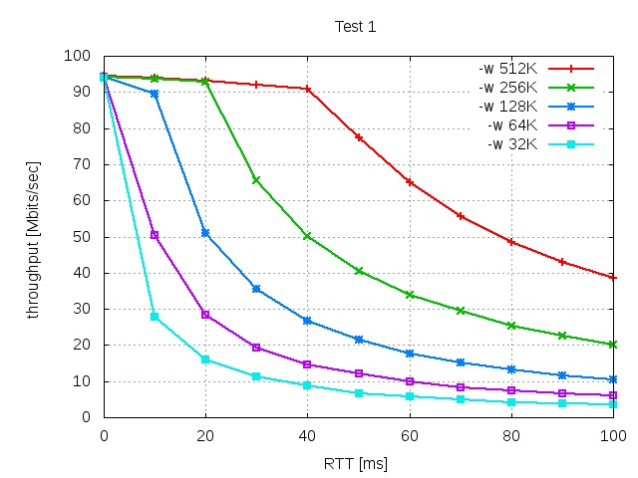
Impact of client RWND
Notes:
MARCO:
Aggiunte slide con prestazioni al variare del RTT, con un sender RENO
Introduce il problema della limitata finestra di ricezione

Slide 22
Impact of client RWND
C=line capacity
RWND/RTT
Notes:
MARCO:
Aggiunte slide con prestazioni al variare del RTT, con un sender RENO
Introduce il problema della limitata finestra di ricezione

Slide 23
TCP window scaling option
The RWND field is 16 bit => MaxRWND = 2¹⁶=64kB
This limits the throughput to
Throughput <= 64kB/RTT
To allow faster throughput on high speed/large RTT paths, scale the window (RFC 1323)
  During the three way handshake, the client and server agree on a scaling factor
  Uses option field in TCP header
Default for modern OSes
  Only Windows XP did not enable this by default
  Can limit the download speed even on a 20Mb/s ADSL line
Notes:
MARCO:
Aggiunte slide con prestazioni al variare del RTT, con un sender RENO
Introduce il problema della limitata finestra di ricezione

Slide 24
TCP congestion control
Originally (<1988) TCP was relying only on the window control operated by the receiver to enforce flow control
  Relatively lightly loaded networks
  TCP connection limited by the receiver speed
Congestion effect is segment drops, which implies throughput reduction due to frequent retransmissions
Goals of congestion control
  Adjusting to the bottleneck bandwidth
  Adjusting to bandwidth variations
  Fairly sharing bandwidth between flows
  Maximizing throughput
Notes:
18

Slide 25
TCP congestion control
Besides the limitation imposed by the receiver through the receiver window (rwnd), the TCP transmitter controls the network congestion through the congestion window (cwnd)
TCP transmitter can send up to B bytes without receiving an ACK, where
B = min (rwnd, cwnd)
Several versions of TCP congestion control defined to compute cwnd
  Reno (NewReno)
  SACK
  BIC and CUBIC
  Many others (Tahoe, Vegas, Westwood, fastTCP, highspeedTCP,…)
Notes:
19

Slide 26
Congestion Window (cwnd)
Limits amount of in transit data
Measured in bytes
wnd = min(cwnd, rwnd)
effective_wnd = wnd –
(last_byte_sent – last_byte_acked);
last_byte_acked
last_byte_sent
effective_wnd
wnd

Slide 27
TCP congestion control
Obvious idea
  Try to adapt rate to available resources
  Increase rate (cwnd) when not congested
  Decrease rate (cwnd) when congestion detected
Issues
  How much to decrease/increase?
  How to detect congestion?
    Packet loss => congestion
      Timeout expiration
      Duplicate ACKs
  Need to probe for available bandwidth
    How to start?
    How to proceed when congestion is detected?
  Must work for greedy source but also for …. (e.g. telnet)
Notes:
19

Slide 28
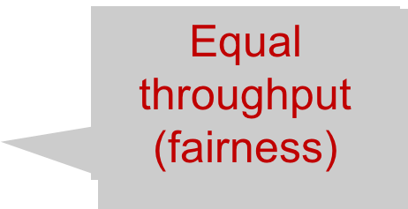

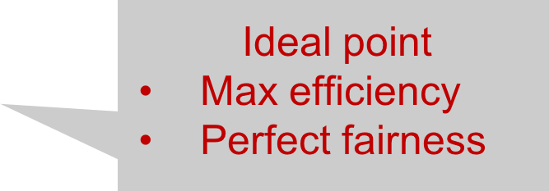

Utilization and Fairness
More than full utilization
(congestion)
Connection 2 Throughput
Connection 1 Throughput

Slide 29
Multiplicative Increase
Additive Decrease
Not stable!
Moves away from fairness
Connection 2 Throughput
Connection 1 Throughput

Slide 30
Additive Increase
Additive Decrease
Stable
But does not converge to fairness
Connection 2 Throughput
Connection 1 Throughput

Slide 31
Multiplicative Increase
Multiplicative Decrease
Stable
Does not converge to fairness
Connection 2 Throughput
Connection 1 Throughput

Slide 32
Additive Increase
Multiplicative Decrease
Stable
Converges to ideal working point
AIMD algorithm
Connection 2 Throughput
Connection 1 Throughput

Slide 33
TCP congestion control algorithm
Tahoe version (1988)
Maintains an additional variable (besides cwnd and rwnd)
  ssthresh: threshold
  Heuristically set to represent an “optimal” window value
Two phases of congestion control
  Slow start (cwnd < ssthresh)
    Probe for bottleneck bandwidth
  Congestion avoidance (cwnd >= ssthresh)
    Probe for bottleneck bandwidth
    AIMD
Note: algorithm description assumes for simplicity that each TCP segment has a size equal to 1 MSS

Slide 34
Slow Start agorithm
Main ideas
  Run when cwnd<ssthresh
  Starts at slow pace but increase fast
At connection startup
  cwnd = 1 segment (more precisely, cwnd=1MSS)
  sstresh = rwnd
For each in sequence ACK received, cwnd = cwnd + 1MSS
Exponential window growth
  For each RTT, cwnd size doubles
  Not slow!
Continues until
  ssthresh is reached
  A segment is lost
Notes:
21

Slide 35

Slow Start algorithm
Host A
Host B
1 segment
RTT
2 segments
4 segments
time

Slide 36
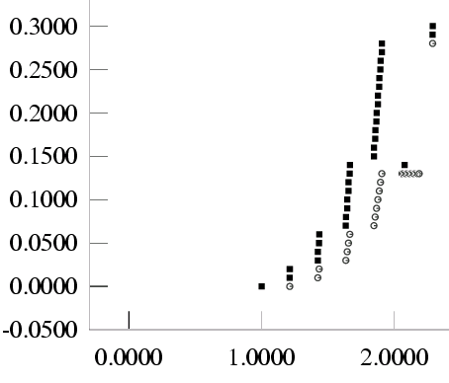
Slow Start: example

Slide 37
Congestion Avoidance algorithm
Main ideas
  Run when cwnd>=ssthresh
  Slow down window growth but keep increasing to probe for additional available bandwidth
For each in sequence ACK received
  cwnd = cwnd + 1/ cwnd or
  cwnd = cwnd + MSS/ cwnd (in byte)
Linear window growth
  Every RTT, the window increases by 1 MSS in absence of losses
  ADDITIVE increase
Continues until a segment is lost

Slide 38
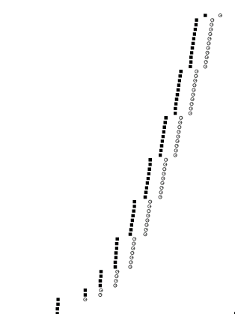
Congestion Avoidance: example

Slide 39
If one segment is lost…
…congestion indication
  Transmitter bit rate overcame available bit rate
Main ideas:
  TCP transmitter re-send the missing segment if the proper ACK is not received within the timeout expiration (“all segments lost” is a severe congestion scenario)
  Reset the window value (cwnd=1)
  Set the threshold to half the current window to ensure a fast cwnd increase
    ssthresh = max(min(cwdn,rwnd)/2,2),

Slide 40
Summary
1) cwnd = 1 MSS
ssthresh = rwnd
2) cwnd = cwnd + 1 for each ACK until
cwnd > ssthresh (goto 3)
if timeout expires:
ssthresh = min(cwnd,rwnd)/2
cwnd = 1
goto 2)
3) cwnd = cwnd + 1/ cwnd for each ACK
if timeout expires:
ssthresh = min(cwnd,rwnd)/2
cwnd = 1
goto 2)
SLOW START
CONGESTION
AVOIDANCE
Notes:
24

Slide 41
Summary
20
RTO
congestion
avoidance
cwnd
15
10
ssthresh
5
slow start
Time [RTT]

Slide 42
Fast Retransmit and Fast Recovery
Further modification to the congestion control algorithm proposed in 1990 (RFC 2001, Stevens)
It allows the “immediate” retransmission of a single segment lost (Fast Retransmit)
  Single segment loss is an indication of mild congestion
…and avoids to re-start the algorithm in the Slow Start phase when a single segment was lost (Fast Recovery)
Notes:
26

Slide 43
Fast Retransmit
Observe duplicate ACKs
  If few duplicate ACKs, it may be an out of order segments delivery
  If more duplicate ACKs are lost, strong indication of segment loss
    However, since duplicate ACKs are received at the transmitter, other segments were received, which implies mild congestion
If three duplicate ACKs are received, re-transmit the missing segment without waiting for timeout expiration (Fast Retransmit)
Gruppo Reti - Politecnico di Torino
Notes:
27

Slide 44
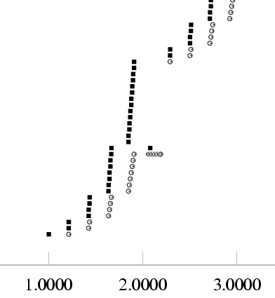
Fast Retransmit: example

Slide 45
Fast Recovery
When congestion detected, go into congestion avoidance phase, and avoids slow start
When the 3rd duplicate ACK is received:
  ssthresh = min(cwnd,rwnd)/2
  re-transmit the missing segment
  cwnd=ssthresh+3
    To keep constant the number of segments in the pipe
For each successive duplicate ACK
  cwnd=cwnd+1
  enable segment transmission also during Fast Recovery
When an ACK confirms the missing segment:
  cwnd=ssthresh
  cwnd=cwnd+1/cwnd for each correct and in sequence ACK
Notes:
28

Slide 46
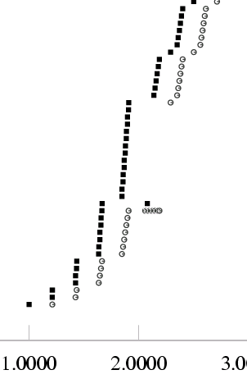
Fast Recovery: example

Slide 47
Summary
3 dupACK
20
congestion
avoidance
15
cwnd
10
ssthresh
5
slow start
Time [RTT]

Slide 48
Summary
3 dupACK
20
congestion
avoidance
Gain with respect
To SS + CA
15
cwnd
10
ssthresh
5
slow start
Time [RTT]

Slide 49
Fast Retransmit and Fast Recovery
At steady state, cwnd oscillates around the optimal window size
TCP always forces packet drops
ssthresh
Timeout
Congestion Avoidance
Fast Retransmit/Recovery
Timeout
cwnd
Slow Start
Time

Slide 50
TCP versions
TCP Tahoe (Included in 4.3BSD Unix)
  Originally proposed by Van Jacobson
    Slow start
    Congestion avoidance
    Fast retransmit
TCP Reno (Proposed in 1990)
  All TCP Tahoe algorithms
  Adds
    Fast-recovery
    Delayed ACKs
    Header prediction to improve performance in HW

Slide 51
TCP Reno: Delayed ACK
Motivations to delay ACK transmission
  To reduce the number of ACKs sent (reduce control traffic)
  To exploit piggybacking to send ACKs
    The application may create data as a response to received segment
  To declare a larger rwnd
    The receiver may empty the reception buffer, declaring larger available window rwnd
Disadvantages
  Increases connection RTT (Round Trip Time)
  Window growth is slowed down

Slide 52
Delayed ACK: RFC
The delayed ACK algorithm (RFC 1122, 1989) SHOULD be used by a TCP receiver. When used, a TCP receiver MUST NOT excessively delay acknowledgments. Specifically, an ACK SHOULD be generated for at least every second full-sized segment, and MUST be generated within 500ms of the arrival of the first unacknowledged segment.
Out-of-order data segments SHOULD be acknowledged immediately, to accelerate loss recovery.

Slide 53
Delayed ACK : algorithm
ACKs are sent
  either every 2 received-in-sequence segments
    Window growth halved
  or 200ms after segment reception
Immediate ACK transmission only for out-of-sequence segments
  Send ACK for the last in sequence and correctly received segment
    Generates duplicate ACKs
Notes:
22

Slide 54
TCP ACK generation
[RFC 1122, RFC 2581]
Event
in-order segment arrival,
no gaps,
everything else already acked
in-order segment arrival,
no gaps,
one delayed ACK pending
out-of-order segment arrival
higher-than-expect seq. #
gap detected
arrival of segment that
partially or completely fills gap
TCP Receiver action
delayed ACK . Wait up to 500ms
for next segment. If no next segment,
send ACK
immediately send single
cumulative ACK
send duplicate ACK, indicating seq. #
of next expected byte
immediate ACK if segment starts
at lower end of gap

Slide 55
TCP NewReno
RFC2582, proposed in 1999
Solves the TCP-Reno problem
  Multiple segment drops make useless the fast recovery-fast retransmit mechanism
Considers partial ACKs reception during a Fast Recovery as a signal of loss of another segment
  Retransmits immediately
A new status variable, named recovery, is needed
When ACK received
  The Fast Recovery phase is declared ended

Slide 56
TCP NewReno
When the 3rd consecutive duplicate ACK is received :
  ssthresh = min(cwnd,rwnd)/2
  Recovery=highest sequence number transmitted
  Retransmit the missing segment
  cwnd=ssthresh+3
For each successive duplicate ACK
  cwnd=cwnd+1
  Send new segments if possible

Slide 57
TCP NewReno
When an ACK which confirms the missing segment is received:
  If ACK > recovery, then
    cwnd=ssthresh
    Fast Recovery procedure ends
  Else [partial ACK]
    Shrink transmission window by an amount equal to the confirmed segment size
    cwnd=cwnd+1
    Send new segments if cwnd permits

Slide 58
TCP SACK
RFC 2018 - 1996
Introduces selective acknowledge in ACK
  It changes the semantic and format of ACKs
Must be negotiated by TCP transmitter and receiver
  Must understand the new format
Exploits Option field in TCP header to transport SACK information
  The receiver tells the sender what it has and what it is missing
More than one segment per RTT can be retransmitted
  The sender can then retransmit the missing segments in a single RTT

Slide 59
TCP SACK
+--------+--------+
| Kind=5 | Length |
+--------+--------+--------+--------+
| Left Edge of 1st Block |
+--------+--------+--------+--------+
| Right Edge of 1st Block |
+--------+--------+--------+--------+
| |
/ . . . /
| |
+--------+--------+--------+--------+
| Left Edge of nth Block |
+--------+--------+--------+--------+
| Right Edge of nth Block |
+--------+--------+--------+--------+
A block represents a contiguous sequence of bytes correctly received and buffered at the receiver
The receiver sends SACK info only if some out of sequence segments were received
May be used to indicate duplicated segments

Slide 60
TCP variants today
The most popular version try to address three key problems
  TCP poor performance on high bandwidth-delay product network
    How much time is needed to increase cwnd on a 1Gbps link from half utilization to full utilization?
      Using 1500-byte PDU and 100 ms RTT
      Full utilization cwnd = 1Gbps/1500byte ~= 8333 segments
      Half utilization cwnd = 8333/2 = 4166 segments
      cwnd is increased by 1 for each RTT
        4167 RTTs are needed to fully utilized the link
        4167 RTT * 100ms(RTT time) = 6.95minutes
  TCP throughput depends on RTT
    Keep a separate delay based window (Microsoft Windows solution)
  Vast majority of Internet traffic is made by short flows (e.g., HTTP)
    Most TCP flows never leave slow start!
    Increase initial cwnd to 10 (Google, RFC 6928 – 2013)

Slide 61
TCP today
Compound TCP (Windows)
  Based on Reno
  Uses two congestion windows: delay based and loss based
  Thus, it uses a compound congestion controller
TCP CUBIC (Linux)
  Enhancement of BIC (Binary Increase Congestion Control)
  Window size controlled by cubic function
  Parameterized by the time T since the last dropped packet

Slide 62
High Bandwidth-Delay Product
Key Problem: TCP performs poorly when
  The capacity of the network (bandwidth) is large
  The delay (RTT) of the network is large
  Or, when bandwidth * delay is large
    b * d = maximum amount of in-flight data in the network
    a.k.a. the bandwidth-delay product
Why does TCP perform poorly?
  Slow start and additive increase are slow to converge
  TCP is ACK clocked
    i.e. TCP can only react as quickly as ACKs are received
    Large RTT → ACKs are delayed → TCP is slow to react

Slide 63
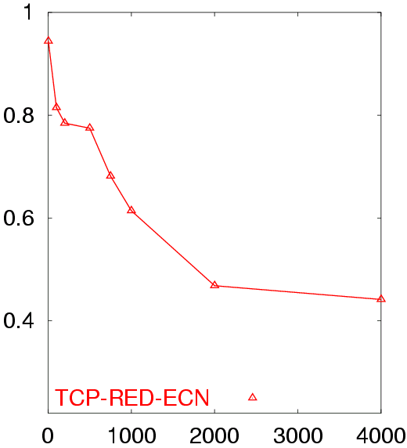
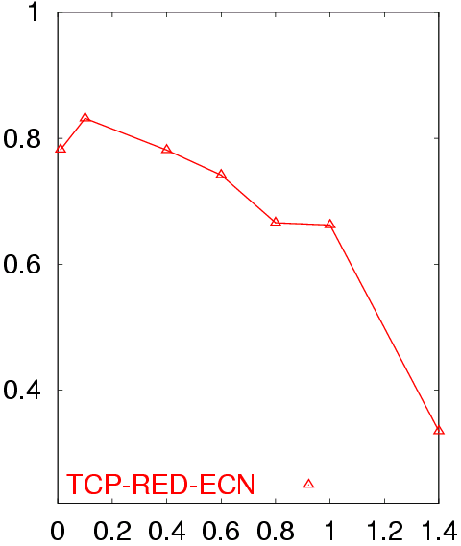
Poor Performance of TCP Reno
50 flows in both directions
Buffer = BW x Delay
RTT = 80 ms
50 flows in both directions
Buffer = BW x Delay
BW = 155 Mb/s
Avg. TCP Utilization
Avg. TCP Utilization
Bottleneck Bandwidth (Mb/s)
Round Trip Delay (sec)

Slide 64
Goals
Speed up cwnd growth
  Slow start and additive increase are too slow when bandwidth-delay is large
  Want to converge more quickly
Maintain fairness with other TCP variants
  Window growth cannot be too aggressive
Improve RTT fairness
  TCP Tahoe/Reno flows are not fair when RTTs vary widely
Simple implementation

Slide 65
Compound TCP Implementation
Default TCP implementation in Windows
Key idea: split cwnd into two separate windows
  Traditional, loss-based window
  New, delay-based window
wnd = min(cwnd + dwnd, rwnd)
  cwnd is controlled by AIMD
  dwnd is the delay window
Rules for adjusting dwnd:
  If RTT is increasing, decrease dwnd (dwnd >= 0)
  If RTT is decreasing, increase dwnd
  Increase/decrease are proportional to the rate of change

Slide 66
Compound TCP Example
Advantages: fast ramp up, more fair to flows with different RTTs
Disadvantage: must estimate RTT
Faster cwnd growth
High
RTT
Low
RTT
Slower cwnd growth
Timeout
Timeout
cwnd
Slow Start
Time

Slide 67
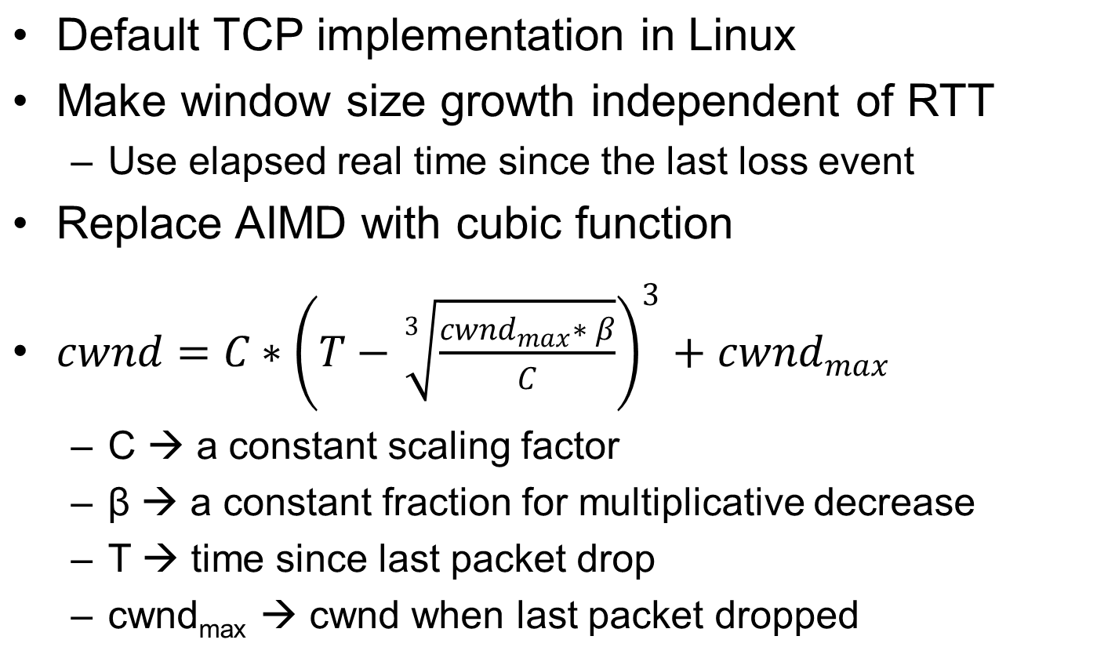
TCP CUBIC Implementation

Slide 68
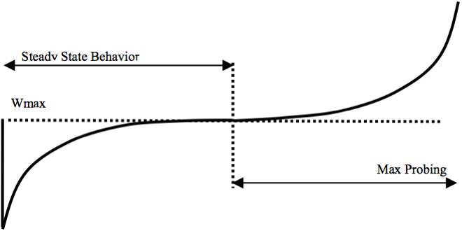
TCP CUBIC
Max Probing
Cubic starts probing for more Bandwidth
Packet loss event
W_{max}
Time
Fast growth upon reduction
Around CWND_{max}, window growth almost becomes zero
Steady State Behavior
Notes:
Marco: Aggiunta slide che spiega la funzione cubica centrata in CWND_max,

Slide 69
TCP CUBIC Example
Slowly accelerate to probe for bandwidth
Less wasted bandwidth due to fast ramp up
Stable region and slow acceleration help maintain fairness
  Fast ramp up is more aggressive than additive increase
CUBIC Function
Timeout
cwnd_{max}
cwnd
Stable
Region
Slow Start
Fast ramp up
Time

Slide 70
Timeout setting and RTT estimation
The timeout value is essential to obtain an efficient ARQ mechanism
Timeout cannot be smaller than 200ms (delayed ACK and transmitter clock granularity)
The timeout should be a function of connection RTT, which varies over time, depending on network load (and queueing delay)
A round trip time estimate is needed to set a proper timeout value
Notes:
29

Slide 71
Timeout setting
For each transmitted segment, compute the time difference M between segment transmission and corresponding ACK reception
  Instantaneous RTT sample
  M=t_ack-t_segment
RTT estimate by weighting through an exponential filter with coefficient α:
  RTT=α*RTT+(1-α)*M (α=0.875)
Timeout (RTO) set to:
  RTO= β *RTT (β >1, typically 2)
Notes:
30

Slide 72
Problems in RTT estimate
Re-transmitted segment: RTT estimate?
X
T.O.
RTT estimate may increase without bound if associating the ACK to the first segment transmission!!
RTT
estimation
X
T.O.

Slide 73
Problems in RTT estimate
Re-transmitted segment: RTT estimate?
RTT estimation too small if associating the ACK to segment re-transmission!
T.O.
RTT
estimation

Slide 74
Exponential backoff on the timeout value
RTT samples of re-transmitted segment may provide a wrong estimante
Karn algorithm:
  RTT estimate is not modified unless an ACK for a non retransmitted segment is received
    Not enough! Indeed, if then RTT increase, a new RTT estimate is never obtained since all segment are re-transmitted
  Increase timeout value according to an exponential backoff algorithm for each lost segment, since the RTT estimate is not reliable
    Sooner or later the timeout will assume a value larger than the current RTT; and a new RTT estimate is obtained
Gruppo Reti - Politecnico di Torino
Notes:
31

Slide 75
Problems in RTT estimate
Delay variations may create fluctuations on RTT estimate
  Use more complex formulas to estimate RTT
  Take into account the average estimation error (RFC6298 – 2011, RFC2988 – 2000)
    timeout=average+4*standard_deviation
Gruppo Reti - Politecnico di Torino
Notes:
31

Slide 76
Jacobson/Karels Algorithm
New proposal for RTT estimation
  Diff = SampleRTT - EstimatedRTT
  EstimatedRTT = EstimatedRTT + (δ Diff)
  Deviation = Deviation + δ(|Diff|- Deviation)
  Where δ ranges from 0 to 1
Standard deviation is considered when computing RTO
  RTO = μ EstimatedRTT + φ Deviation
  where μ = 1 and φ = 4

Slide 77
Notes on RTT estimate
Estimate is always constrained by timer granularity (10ms on recent systems, 200ms on older systems)
  The RTT may be comparable with timer granularity (RTT=100-200ms for long distance connections)
Accuracy in RTT estimation is fundamental to obtain an efficient congestion control (avoids useless re-transmissions or excessively long waits)

Slide 78
Timeout setting: problems
Initial value?
Since an RTT estimation is missing, the initial timeout value is chosen according to a conservative approach
  Initial timeout set to 1s (RFC6298)
TCP connections are very sensible to the first segment loss since the timeout value is large

Slide 79
Silly Window Syndrome
Excessive overhead problem due to
  Slow receivers or
  Transmitter sending only small segments
If the receiver buffer fills up, the receiver declares increasingly smaller rwnd
The transmitter sends tinygrams if the applications generates few data (e.g., telnet application)
Notes:
32

Slide 80
TCP connections for telnet traffic
Telnet application
  When pressing a key on the terminal keyboard
  A TCP segment TCP of 1B is sent in a dedicated IP datagram: (20B+20B)header +1B data
Even worse, if local echo disabled, 4 1B segments are sent: key + ACK + echo + ACK
Exploiting piggybacking of the first ACK on the echo segment, one segment is saved
  Delayed ACK helps
Notes:
10

Slide 81
Silly Window Syndrome avoidance
At the receiver side:
  Declare the new available receiver window only if equal to
    1 MSS or
    Half of the receiver buffer
  Delayed acknowledgment
At transmitter side:
  Nagle algorithm
Notes:
33

Slide 82
Nagle algorithm (RFC 896)
When opening the connection, all data in the transmission buffer are sent
Then, wait for
  at least 1 MSS data in the transmission buffer or
  ACK reception
A host never has more than one tinygram without an ACK
Notes:
11

Slide 83
Nagle algorithm
When running a telnet application, successive characters following the first one are collected in a single segment, sent after receiving the first ACK
Ftp, smtp, http connections are not penalized
The number of tinygrams is drastically reduced
Is congestion friendly
  Being ACK clocked, when the network is lightly loaded ACKs are frequently and fastly received and segment transmission is speeded-up
  When network becomes congested, ACKs are delayed and less segments are sent
Notes:
11

